Slide 1
PaNOSC 1st Annual Meeting – Welcome by Project Coordinator
4 November , 2019
Project Coordinator: Andy Götz (ESRF)

Slide 2

WELCOME TO THE 1st PANOSC ANNUAL MEETING !

Slide 3
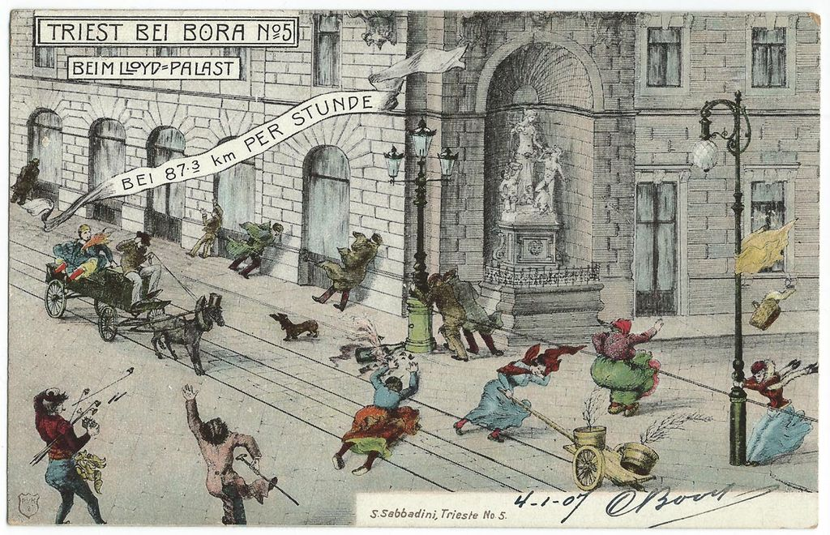

Slide 4
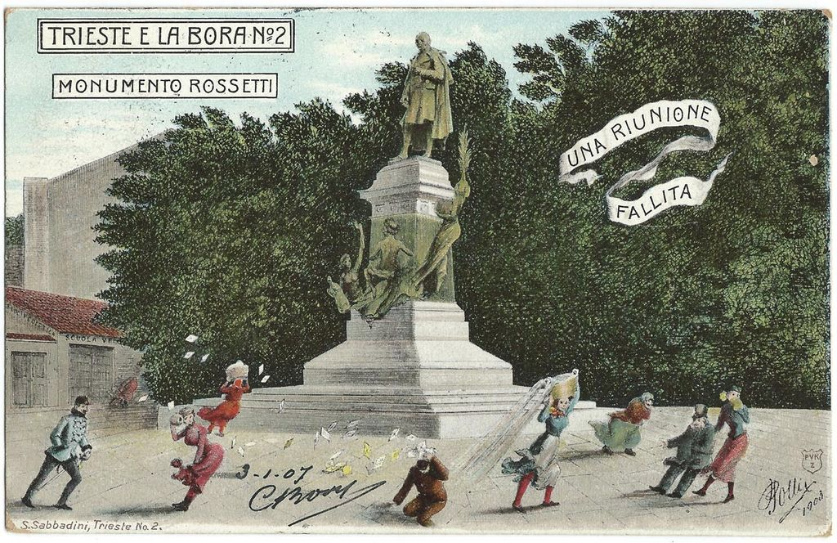

Slide 5
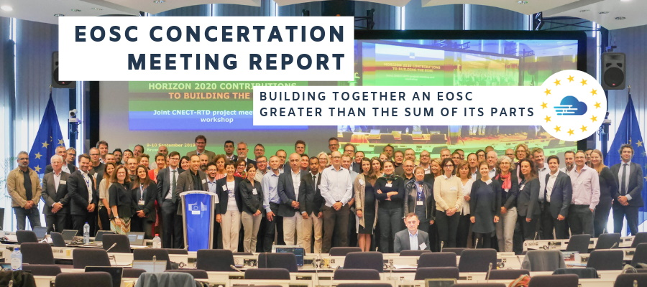
https://www.eoscsecretariat.eu/sites/default/files/final_report_eosc_concertation_workshop.pdf

Slide 6
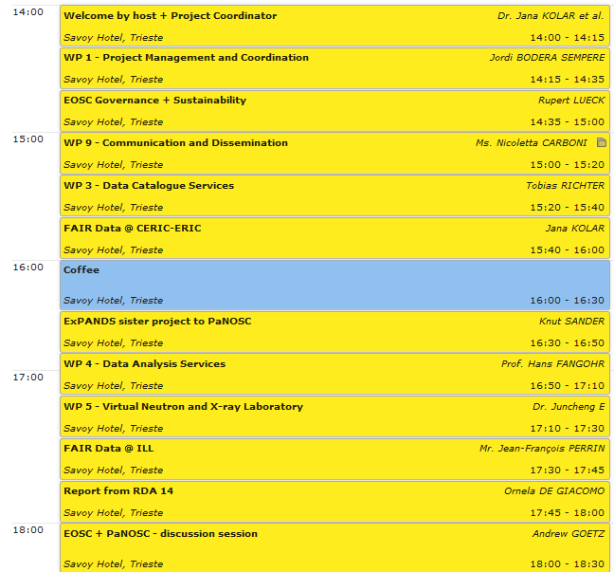
Monday
https://indico.esrf.fr/indico/event/36/

Slide 7
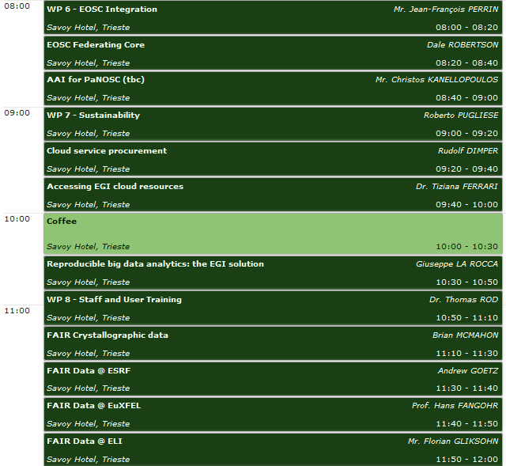
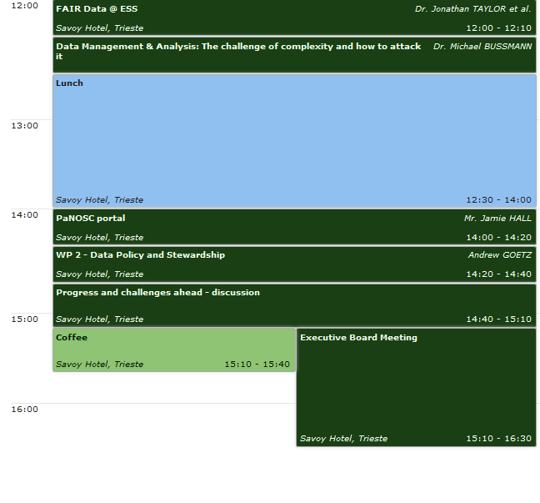
Tuesday
https://indico.esrf.fr/indico/event/36/

Slide 8
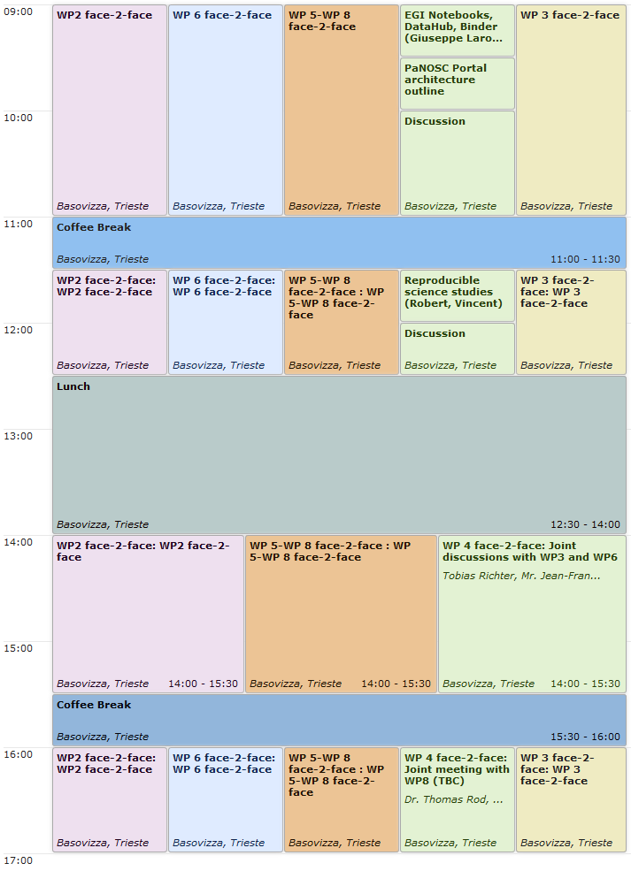
Wednesday
https://indico.esrf.fr/indico/event/36/

Slide 9
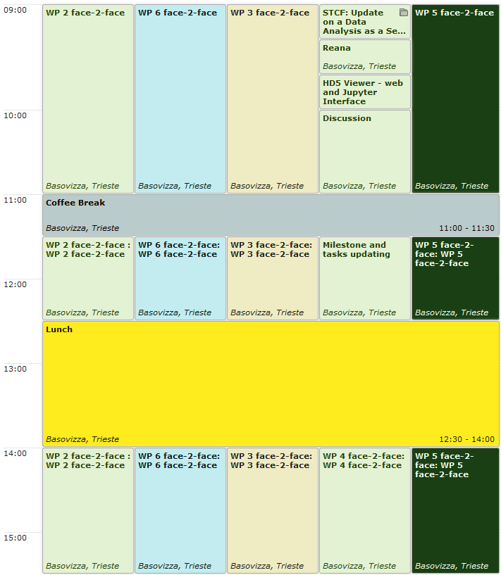
Thursday
https://indico.esrf.fr/indico/event/36/

Slide 10
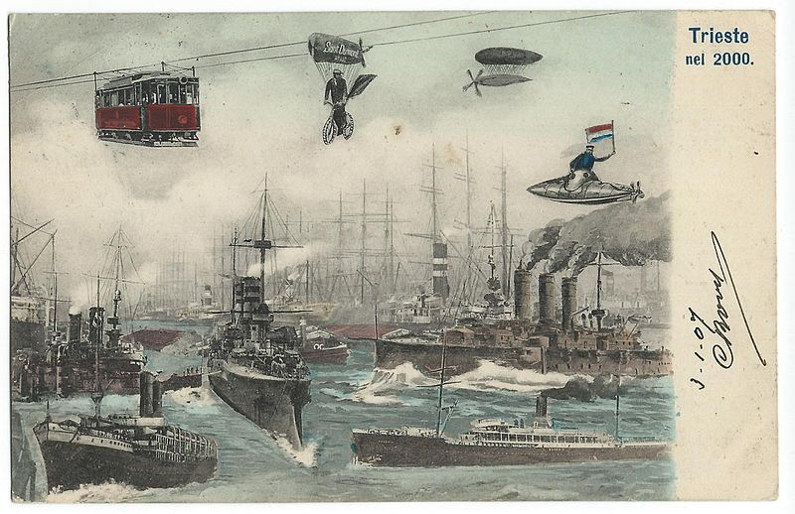
BUILDING THE PANOSC DATA COMMONS TOGETHER
GREATER THAN THE SUM OF ITS PARTS!

